Slide 1
Long Island Population Health Improvement Program
(LIPHIP)
WIFI password: kayla1393
November 15, 2017
This meeting is now being recorded.

Slide 2
2018 Meeting Dates
Registration and Calendar Process

Slide 3
Open Enrollment Period
Nassau-Suffolk Hospital Council
http://coverage4healthcare.org/
631-656-9783

Slide 4
Collective Impact Think Tank
NYS DOH Prevention Agenda 2013-2018
https://www.health.ny.gov/prevention/prevention_agenda/2013-2017/

Slide 5
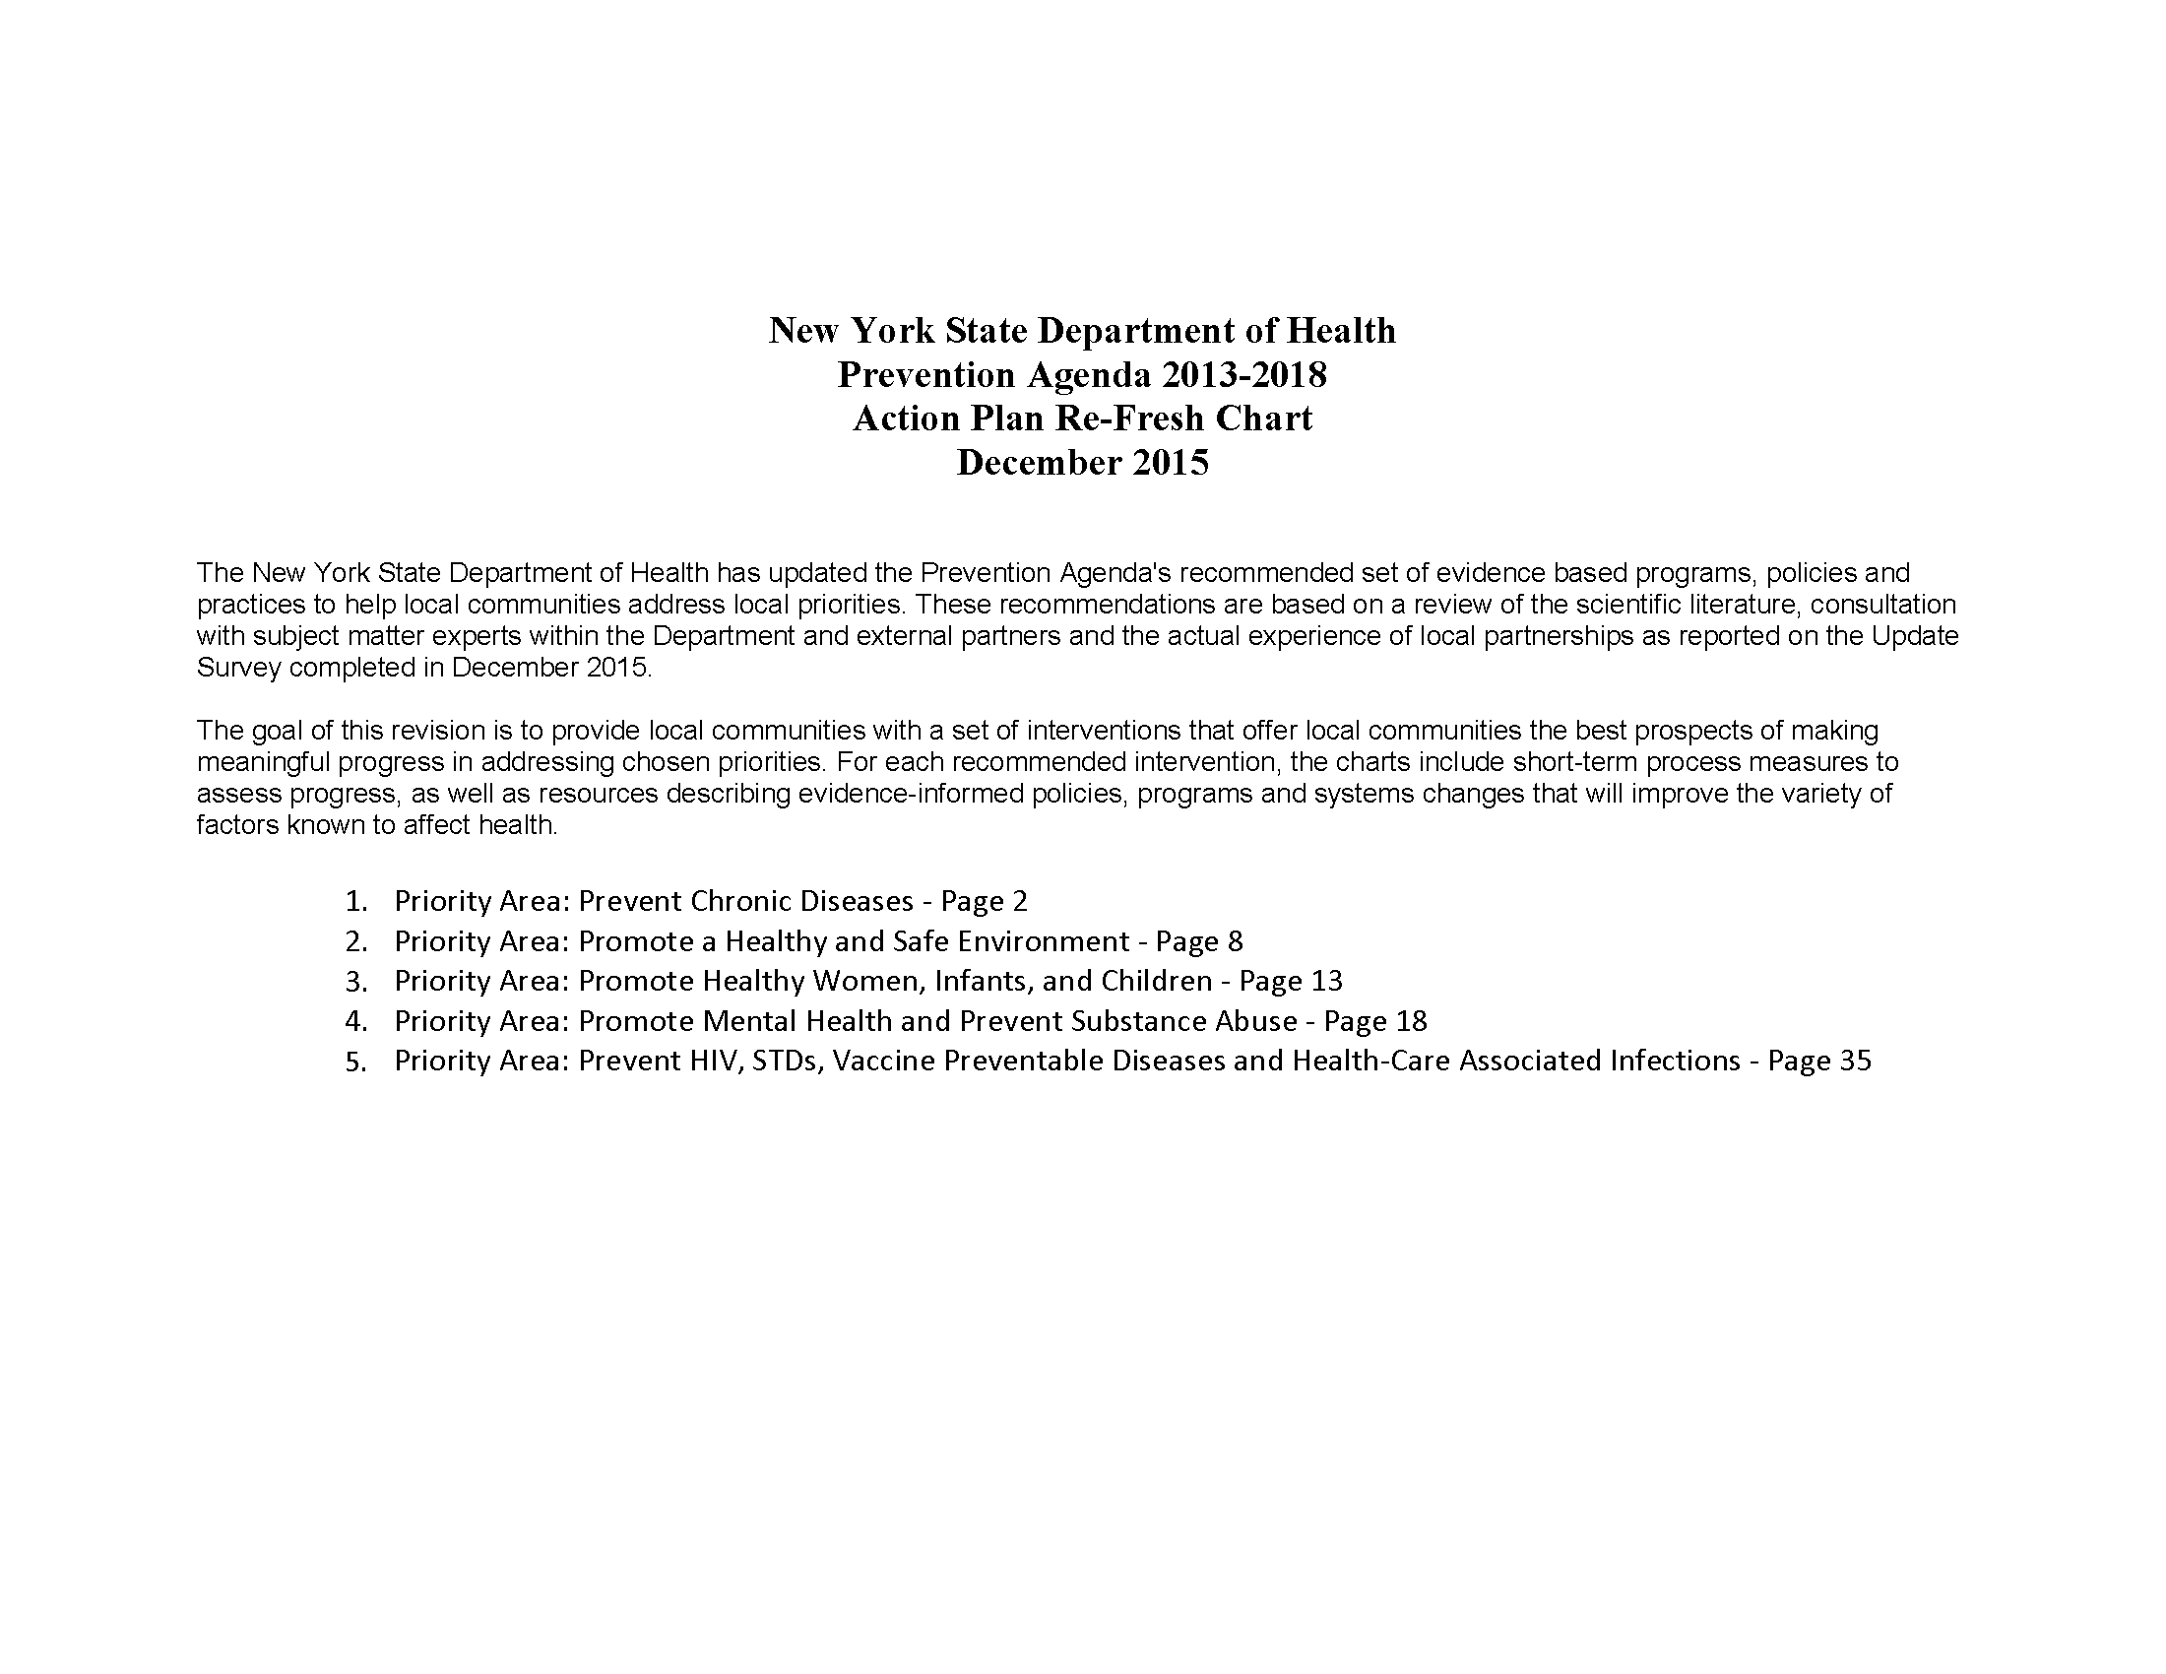

Slide 6
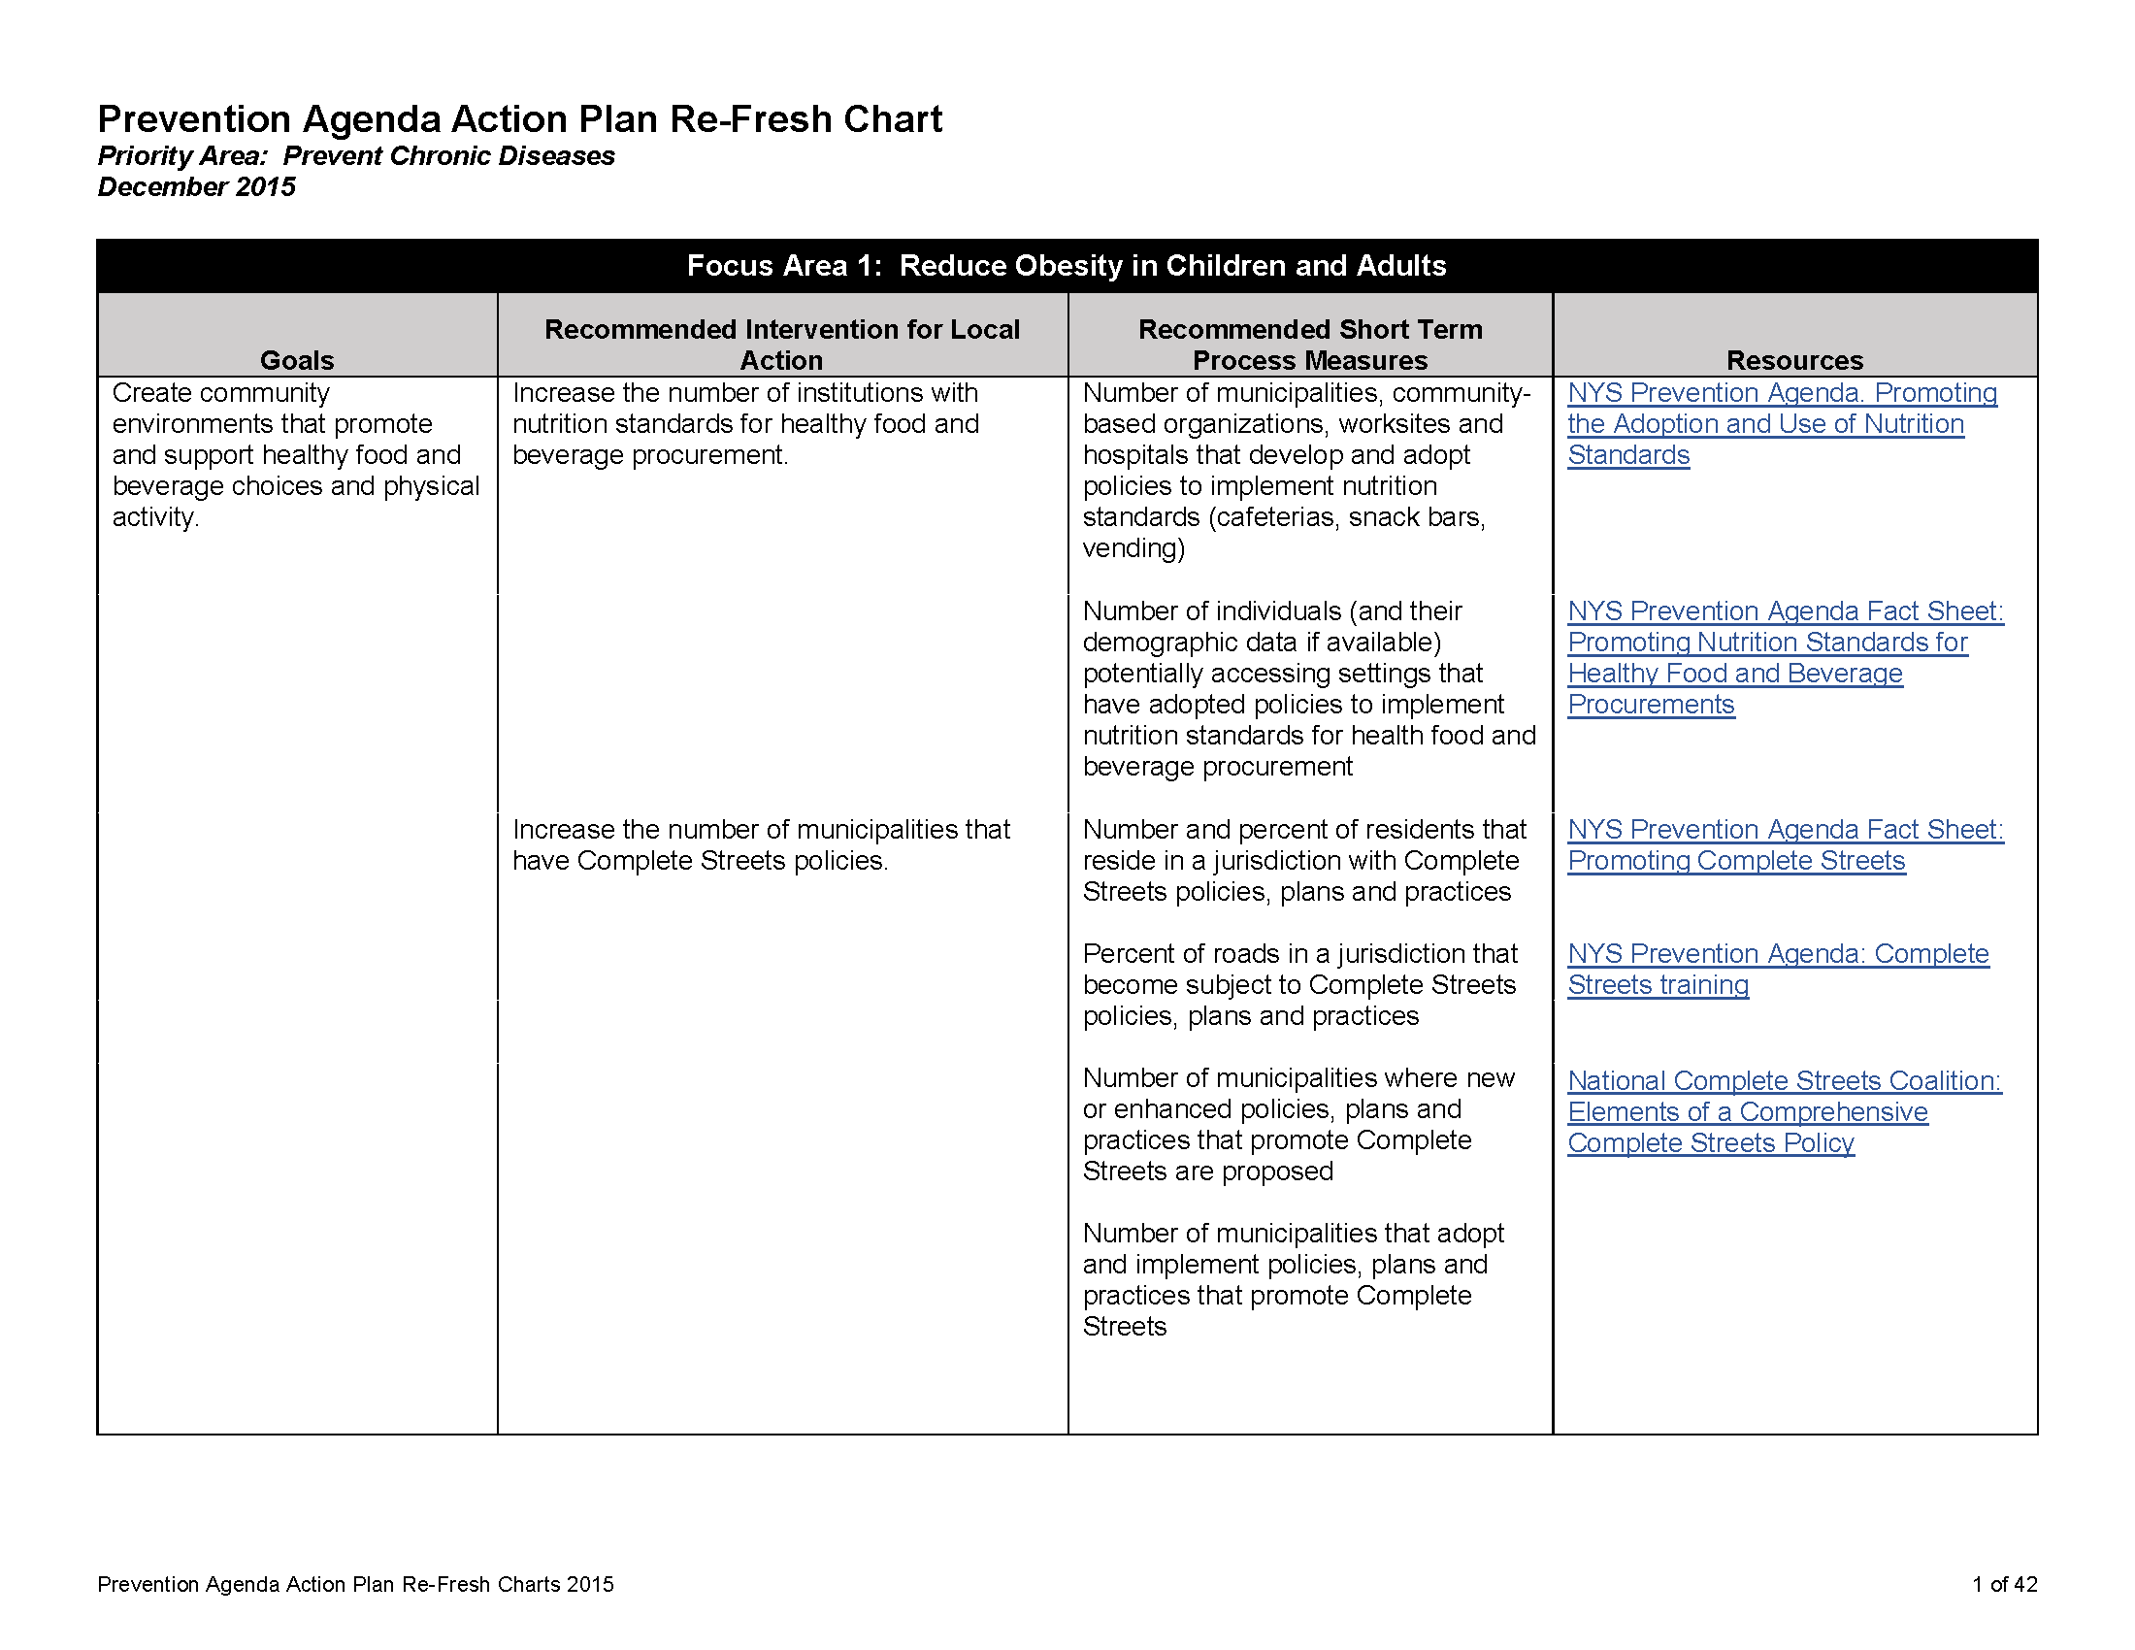

Slide 7
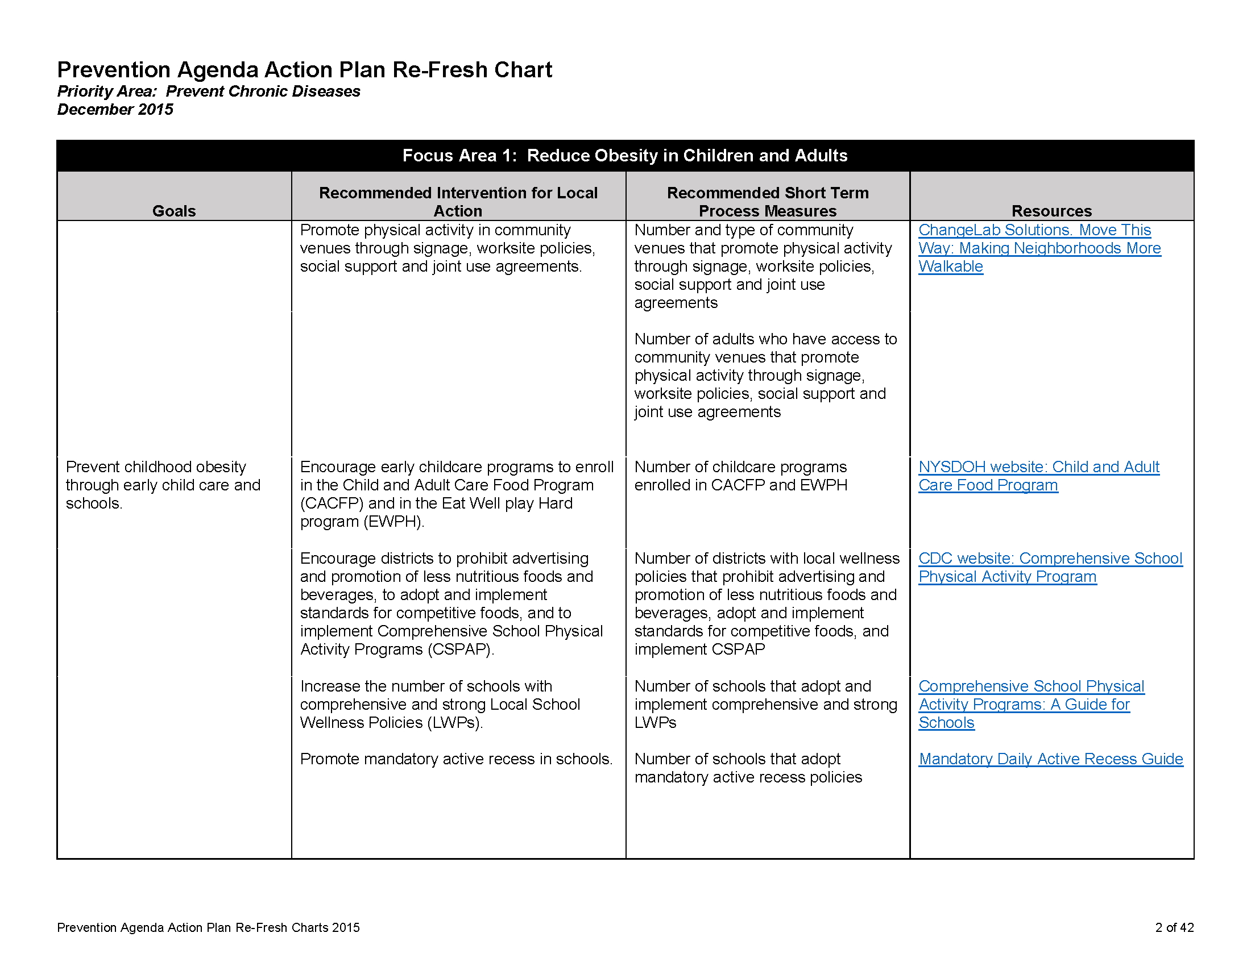

Slide 8
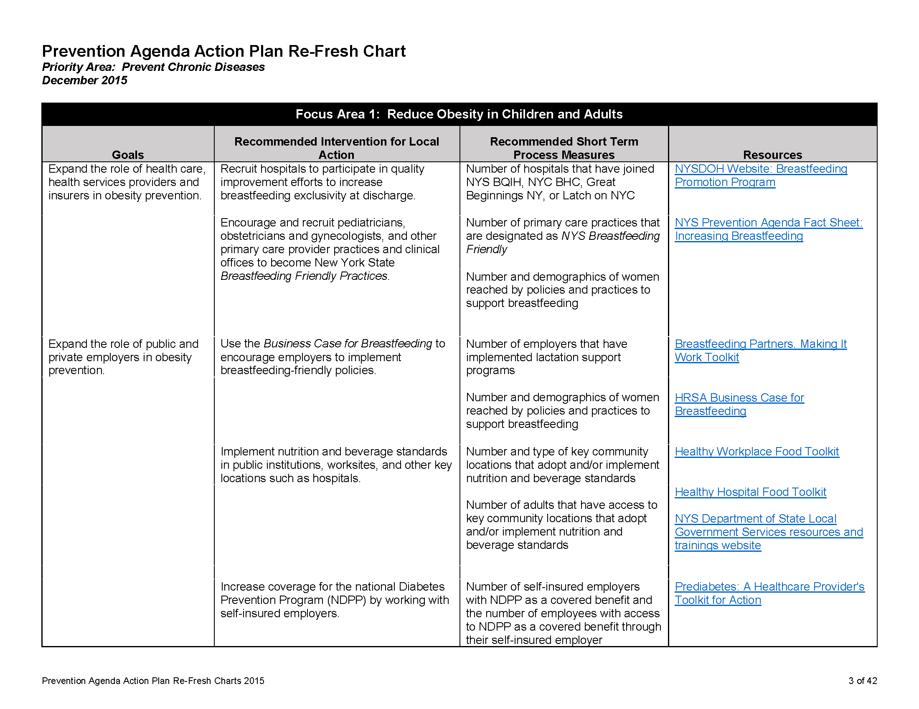

Slide 9
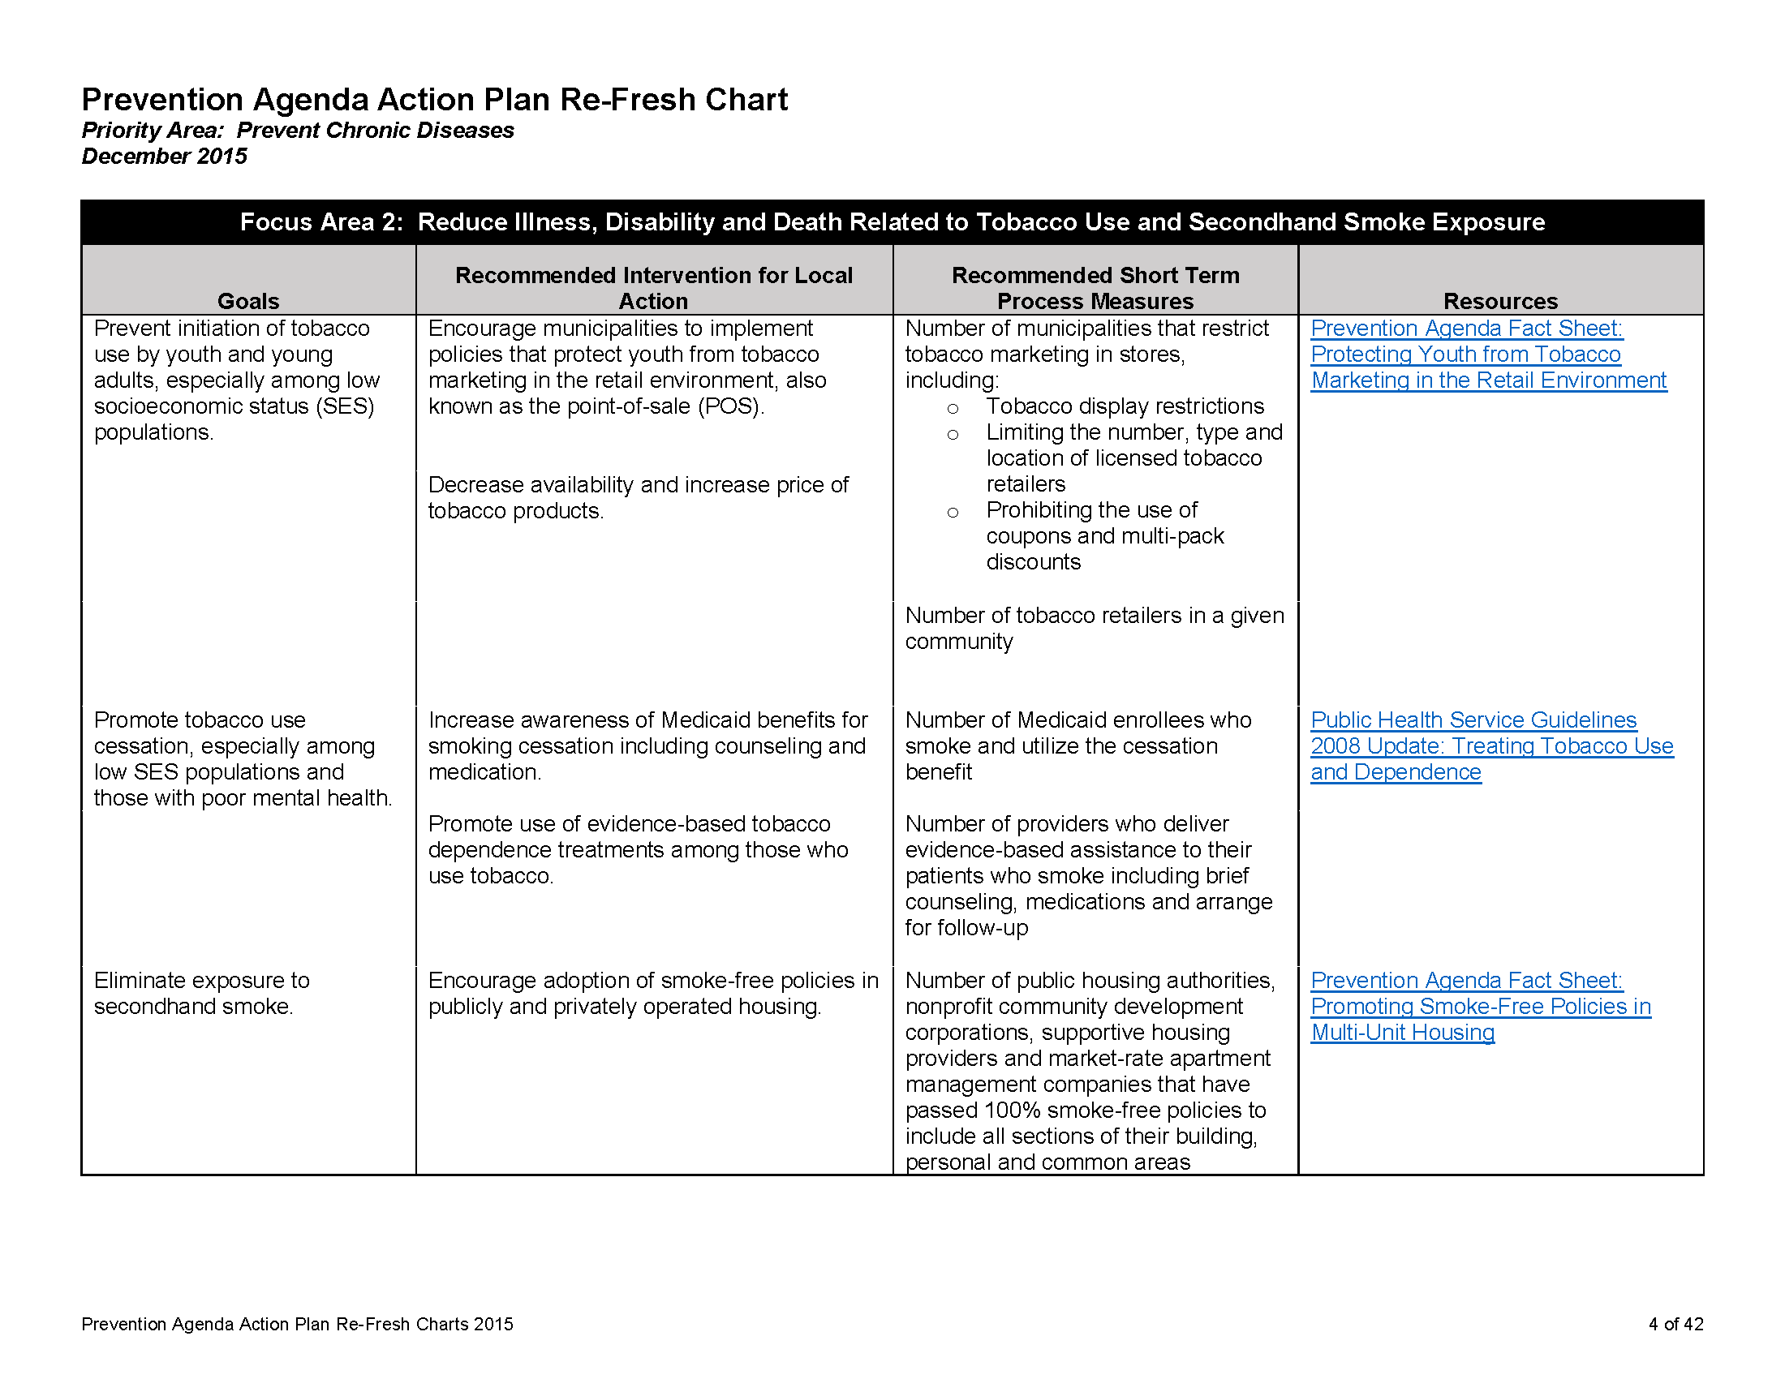

Slide 10
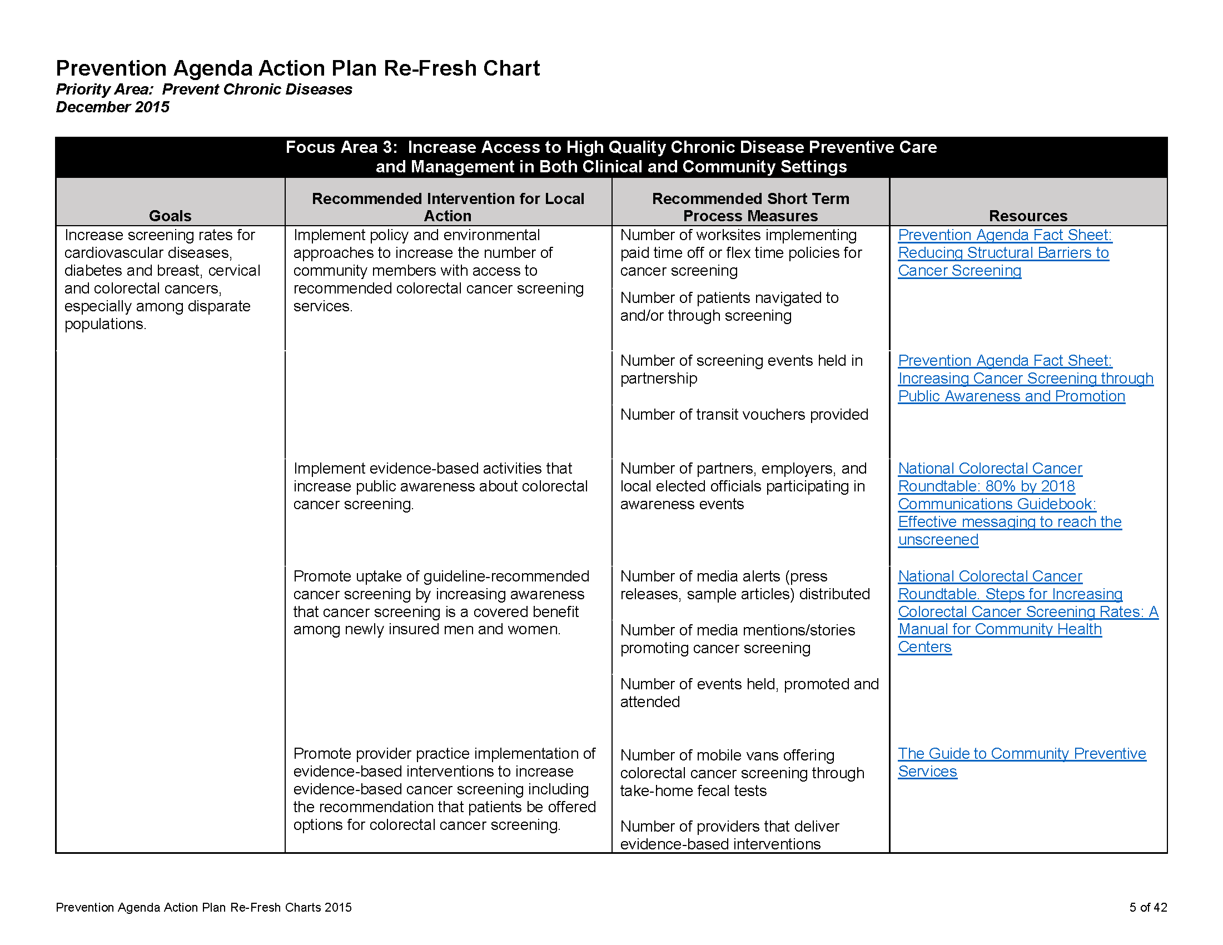

Slide 11
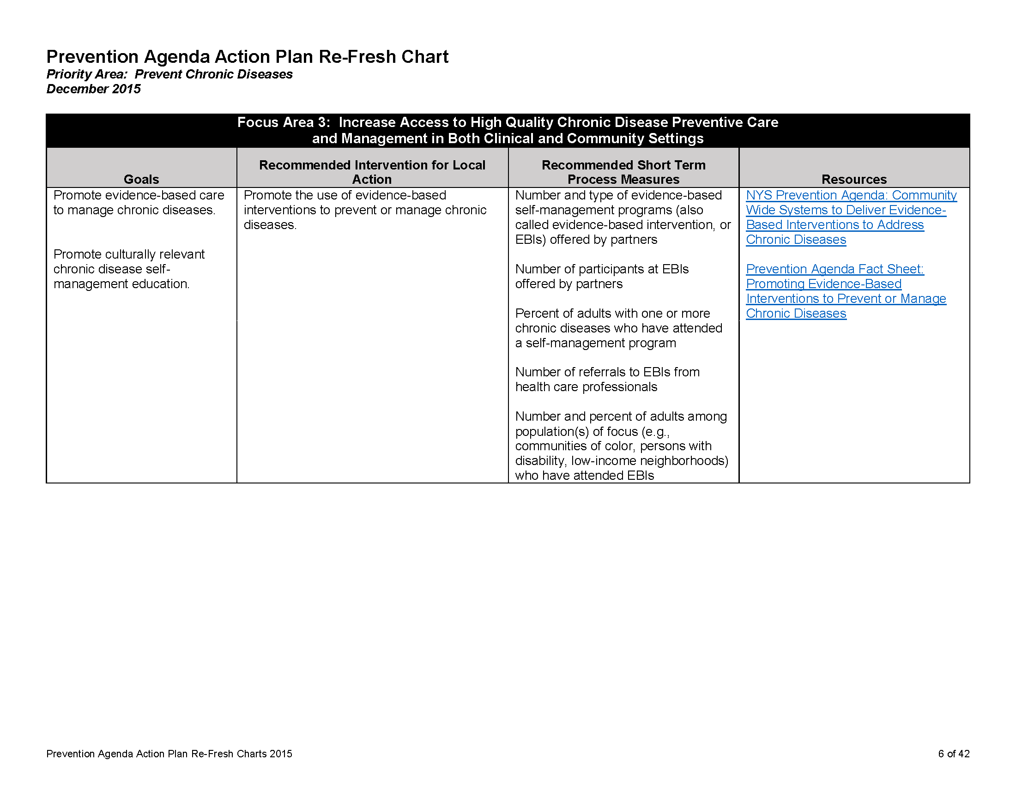

Slide 12
NYS Office of Mental Health Community Resources
Dr. Martha Carlin, Director, Long Island Field Office of Mental Health

Slide 13

Networking & Stretch Break

Slide 14
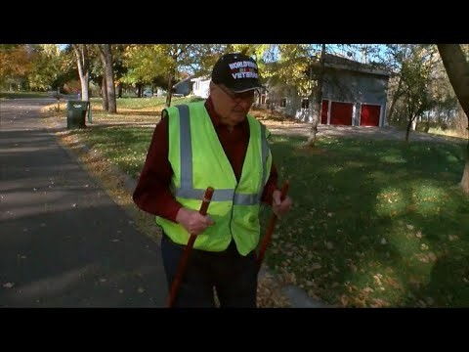
WWII Veteran’s Daily Walks

Slide 15
WWII Veteran’s Daily Walks
https://www.cbsnews.com/videos/neighbors-put-out-chairs-for-wwii-veterans-daily-walks/

Slide 16
CSP/CHIP Update
2017 CSP CHIP Updates due to NYS DOH 12/29/17
  Updating the Prevention Agenda Work Plan
  Completing the online survey
This year, we plan to update the Prevention Agenda Work Plan and conduct a final analysis of the community member survey data so that it can be used within your updates.

Slide 17
SCC updates
Faith communities forum – Save the Date January 2018
Better Choices, Better Health Workshop Series – Partnership opportunities
Work together to communicate these valuable, free programs using our flyers, brochures, and referral forms
~ AND/OR ~
Bring the workshops directly to them at your location(s)
    For more information, please contact:
Lyndsey Clark or Sofia Gondal, Community Engagement Liaisons
Suffolk Care Collaborative
T: 631-638-1779 (Lyndsey) / 631-638-1349 (Sofia)
E: Lyndsey.Clark@stonybrookmedicine.edu / sofia.gondal@stonybrookmedicine.edu

Slide 18
SCC updates
Community Consumer Advisory Council (CCAC) Meeting – Tuesday, November 28th (tentative)
    For more information, please contact:
Lyndsey Clark, Community Engagement Liaison
Suffolk Care Collaborative
T: 631-638-1779
E: Lyndsey.Clark@stonybrookmedicine.edu
Project 4bii Resource Guide – (Ongoing Project) – Next Meeting, Tuesday, November 21st
    For more information, please contact:
Sofia Gondal, MA, Community Engagement Liaison
Suffolk Care Collaborative
T: 631-638-1349
E: sofia.gondal@stonybrookmedicine.edu

Slide 19
Year 4 PHIP Workplan
Scheduled and customized data reports
Reorganization of website
Chronic disease evidence-based programs
Community level engagement
Outreach via social media
Formal partnership with RHIOs

Slide 20
Questions/Feedback?

